Slide 1
CRV Trailblazers

Slide 2
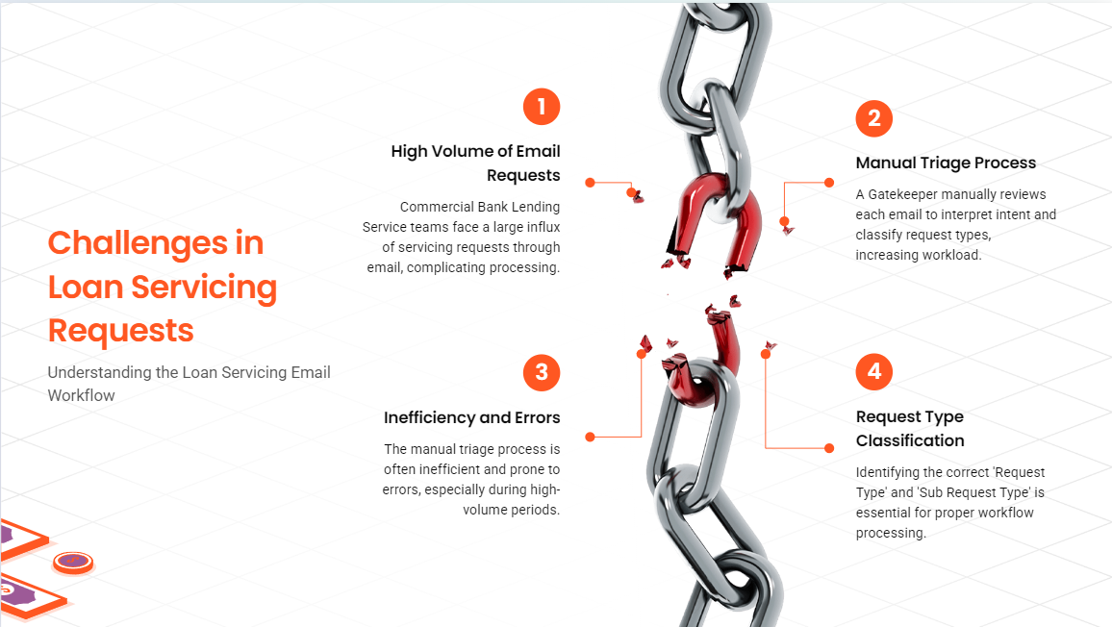
Problem Statement

Slide 3
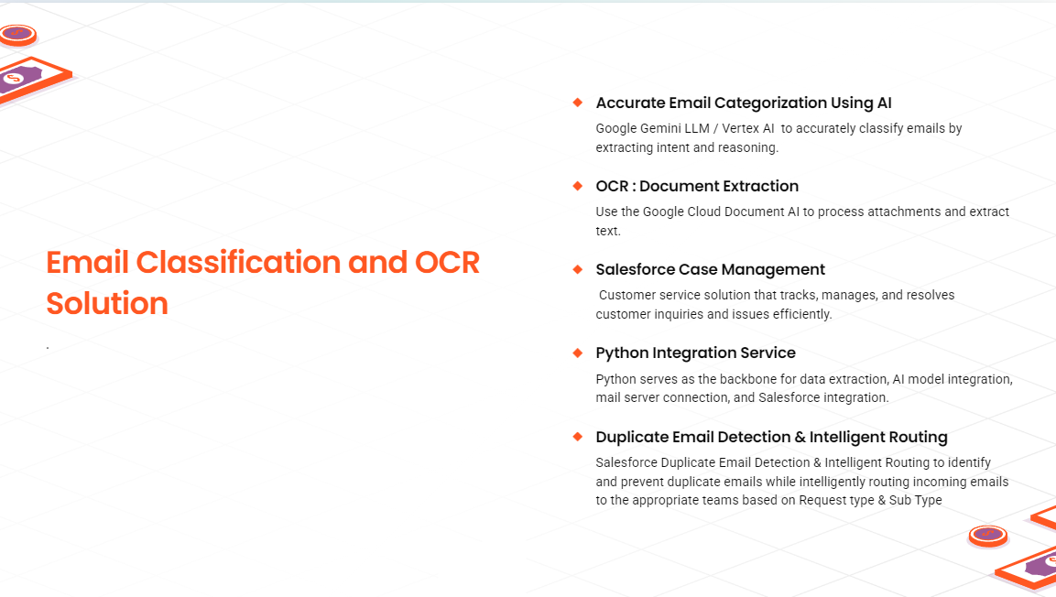
Solution Overview

Slide 4
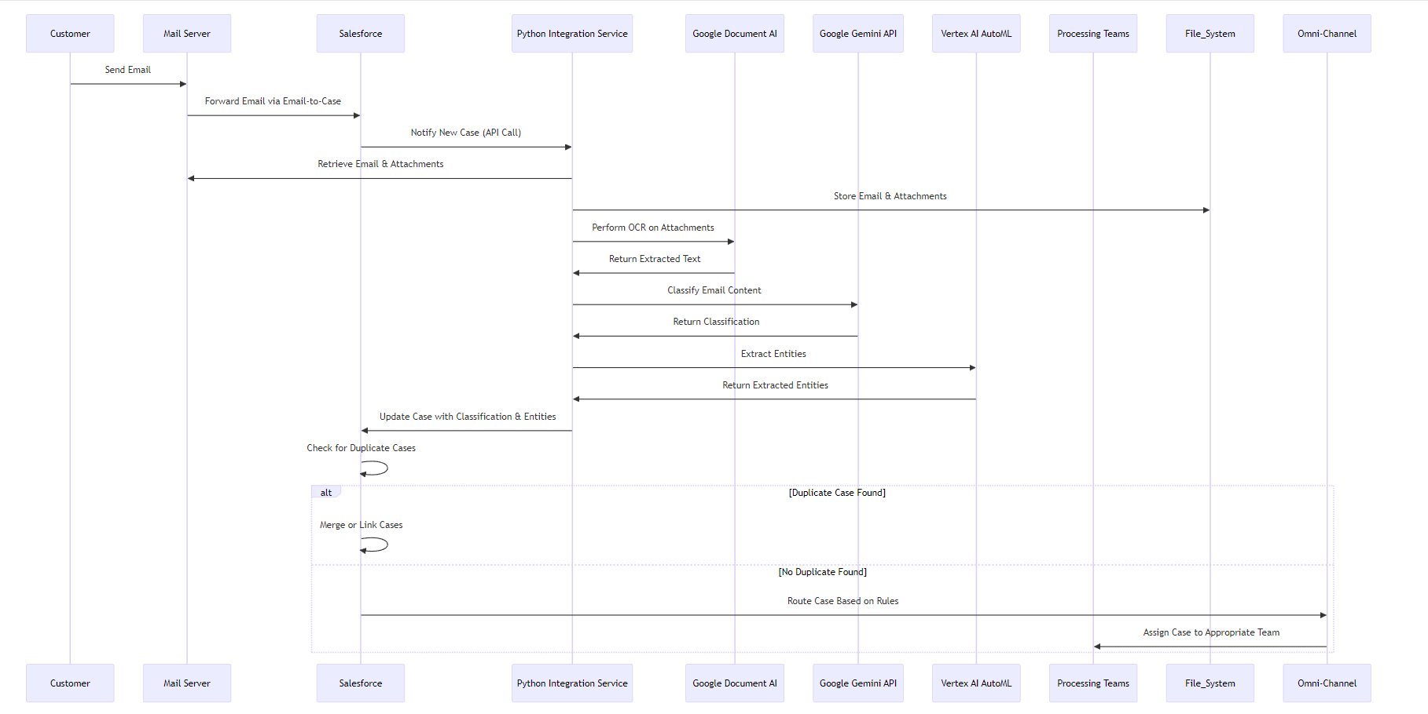
Sequence Diagram

Slide 5
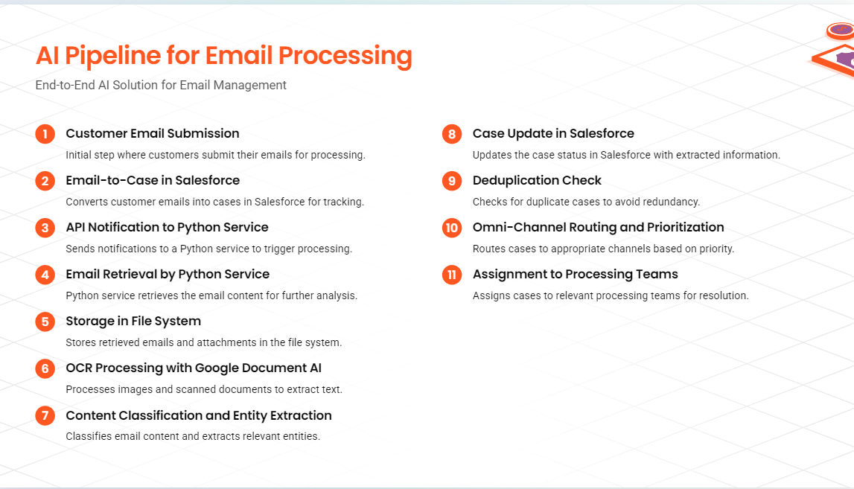
Holistic process View

Slide 6
Holistic process View

Slide 7
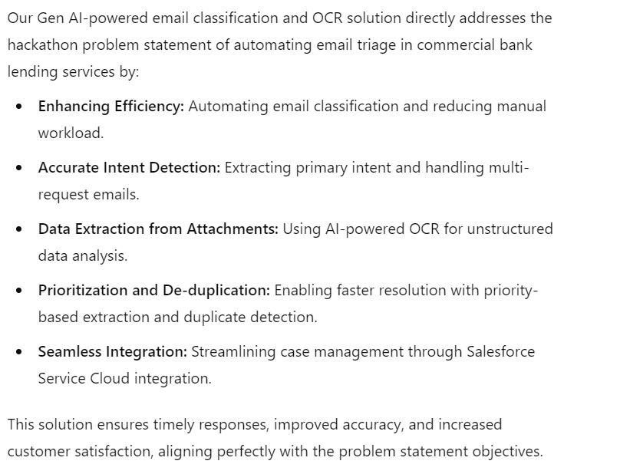
How Our AI Solution Addresses Key Lending Service Pain Points

Slide 8
Thank you

